Slide 1
NewsBusters
Clay Roop, Andy Heymann, Stephanie Lawrie, David Tillack

Slide 2

Story

Slide 3
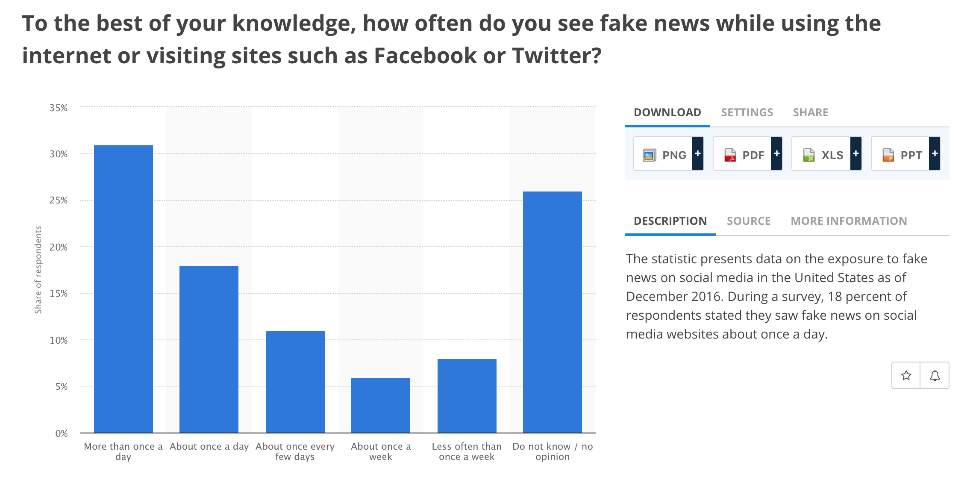

Slide 4
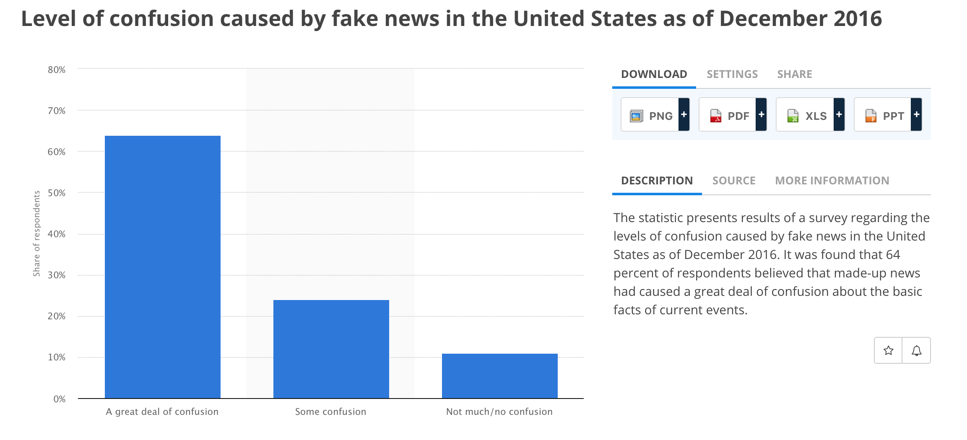

Slide 5
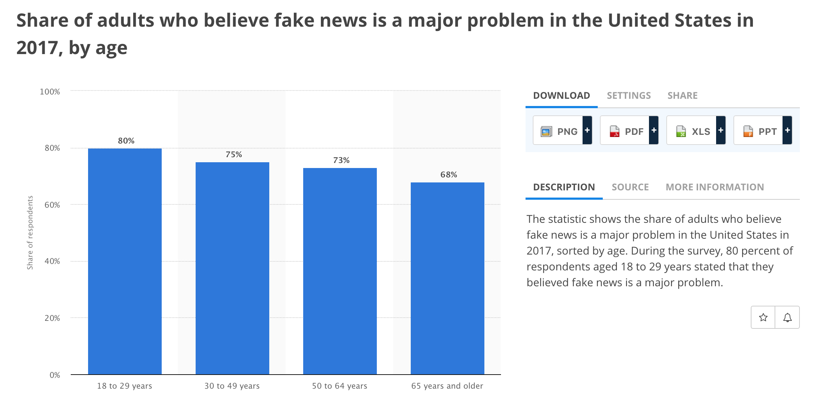

Slide 6
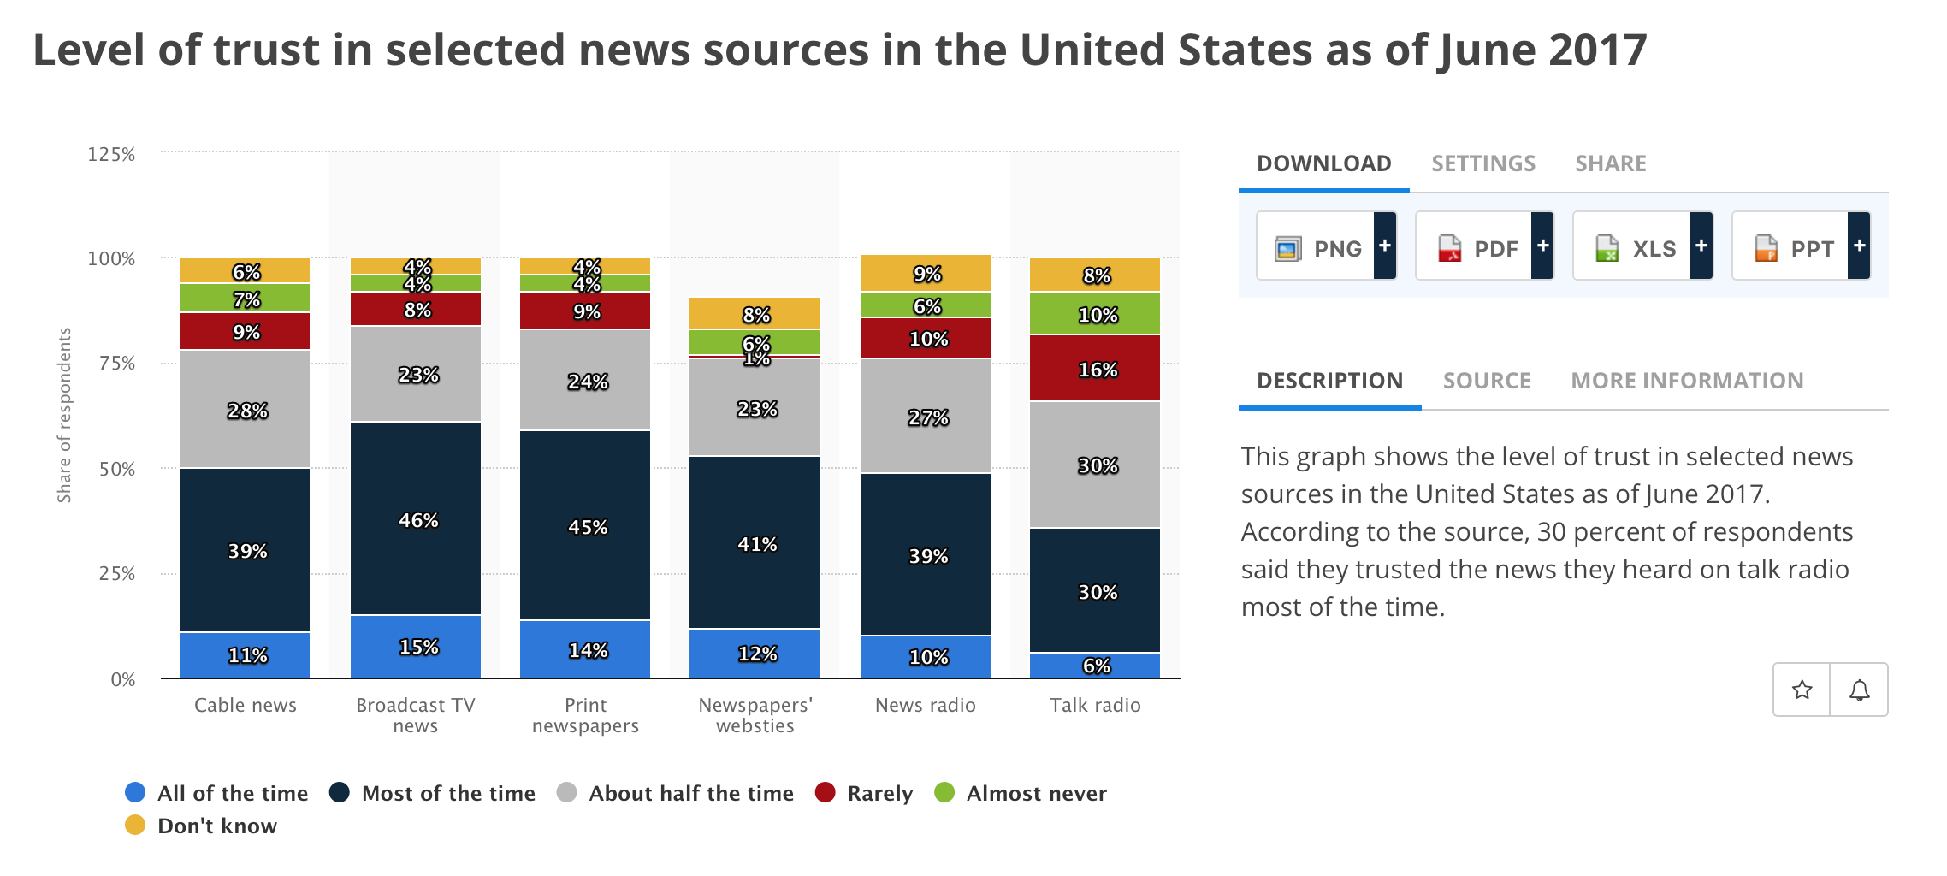

Slide 7
Demo
https://andyclaydavidsteph.github.io/Project1/

Slide 8







Technology

Slide 9
Must uses at least two APIs
Must use AJAX to pull data
Must utilize at least one new library or technology that we haven't discussed
Must have a polished frontend / UI
Must meet good quality coding standards (indentation, scoping, naming)
Must NOT use alerts, confirms, or prompts (look into modals!)
Must have some sort of repeating element (table, columns, etc)
Must use Bootstrap or Alternative CSS Framework
Must be Deployed (GitHub Pages or Firebase)
Must have User Input Validation

